Slide 1
Health Policy Conundrum
Lecture 10
Vinish Shrestha

Slide 2
Econ 339 - Roadmap
Focus Midterm 1
Focus Midterm 2
Focus Final
Review of Microeconomics
Socioeconomic
Disparities
Chapter 4
Moral hazard
Chapter 11
Intro (from my slides)
Demand for Insurance
Chapter 7
Uncertainty
Risk aversion
The American Model
Chapter 18 and slides provided (ACA)
Production of Health
Adverse selection
Chapters 8 and 9
Akerlof’s market for lemons
Rothschild-Stiglitz model
The health policy conundrum
Chapter 15
Demand for health care
Chapter 2
The Beveridge Model
Chapter 16
Adverse Selection in
Real market
Chapter 10
The Grossman model
Chapter 3
Special Topics (if time allows)
Chapter 20
Slides provided
11/26/17
Towson University – V. Shrestha

Slide 3
Market for Health Insurance
Problems
Adverse Selection and underinsurance
Moral Hazard and over use
Health policy tries dealing with these problems. But any health policies will have unintended consequences or just exacerbate the older ones.

Slide 4
Arrows Impossibility Theorem

Slide 5
Transitive preferences and an individual
Rando faces these choices
Painting
Playing guitar
Drinking beer
Rando
Likes painting more than playing guitar
Likes playing guitar more than drinking beer
If we know these two of the above preferences, we can say that Rando likes painting more than drinking beer.

Slide 6
Does transitive preferences work for a society?
In Pcoria (a hypothetical country)
Students and retirees prefer soc libs instead of enviro-greens
Students and workers prefer fed dems instead of soc libs
Hence, Society should prefer fed dems instead of enviro greens
No. We have circular preferences. Now what is best for Pcoria?
Voter Type | 1st Choice | 2nd Choice | 3rd Choice
Students | Fed Dems | Soc Libs | Enviro-Greens
Workers | Enviro-Greens | Fed Dems | Soc Libs
Retirees | Soc Libs | Enviro-Greens | Fed Dems

Slide 7
Arrow’s impossibility theorem
Cannot compare individual’s preferences to society’s preferences
Society is fundamentally difference from individual (due to size)
An individual is presumed to have a consistent and transitive preferences
Welfare economics falls apart without transitive preferences
Ken Arrow (1951) proved that preferences governing a society is not transitive, even though every individual’s preference is transitive
This is known as Arrow’s impossibility theorem

Slide 8
Implications of Arrow’s Impossibility Theorem
Does it make sense to speak of “optimal policy” for a country?
No really
How do we optimize?
What does a society really want?
However policies are made..

Slide 9
Health Policy Trilemma

Slide 10
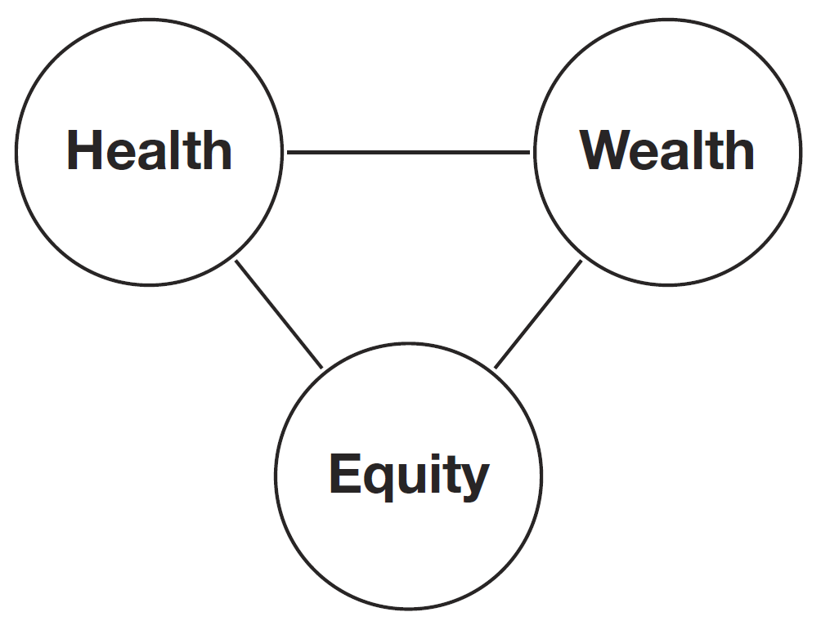
Nation’s Goals
Three broad goals when decision making
Policy designed to move closer to one will involve a trade-off
which will increase the severity of the others
Policy targets equity, increase adverse selection, this will under-
insure people and can affect their health
Check for equity and adverse selection, may increase premiums
and affect wealth

Slide 11
Key health care policy choices
Every policy choice involves a tradeoff between health, wealth and equity (otherwise it would be obvious and probably implemented already).
The policy options that follow are thus presented as answers to the three broad questions that any national health care system must answer:
How should insurance markets work?
How should moral hazard be controlled in public insurance?
How should health care provider markets be regulated?

Slide 12
How should health insurance market work?

Slide 13
Several options
Completely private insurance
Universal public insurance
Compulsory insurance
Employer-sponsored insurance
Means-tested health insurance
None is perfect and they are not mutually exclusive.

Slide 14
1. Completely private insurance
Taxpayers will have to pay low taxes, but many citizens will be deprived of health insurance
The Rothschild-Stiglitz model predicts that in private markets, only sick customers are insured fully (with high premiums)
Much of the population is under insured
Can lead to death spiral
Minimizes government involvement, but results in adverse selection

Slide 15
2. Universal public insurance
The government is the provider of insurance, through taxes
Appeases adverse selection and ends under insurance problem
Provides the goal of equity
Invites moral hazard
Long waiting time?
Higher taxes
“single payer”

Slide 16
3. Compulsory insurance
Tackles adverse selection
A mandate can be expensive
Rolled out with subsidies
Paid with taxes
Designing of the mandate should be carefully done

Slide 17
4. Employer-Sponsored Mandate
Employers are required to provide mandate to all of the employees
Strong incentive for healthy individuals to pool with risky individuals, which mitigates adverse selection.
Can create labor market efficiencies or even inefficiencies
Not appropriate for unemployed individuals

Slide 18
5. Means tested programs
Medicaid as an example
Attempts to improve equity
Higher tax burden and moral hazard
Can invite externalities?

Slide 19
How to control moral hazard?

Slide 20
How should moral hazard be controlled?
Cost Sharing
Gate keeping and queuing
Prospective payments

Slide 21
Cost Sharing
Deductible, coinsurance, copayment
Out of pocket costs when getting medical care service
Cost sharing controls moral hazard but makes health care less affordable to people
Can undermine equity

Slide 22
Cost sharing
Example: the US Medicare system does not fully cover patient costs.
As of 2012, Medicare enrollees must pay the first $1,156 dollars of expenses for each hospital visit and the first $140 of outpatient clinic expenses each year.
They must also start paying $289 per day once a hospital stay lasts longer than 60 days.
This forces enrollees to either economize or purchase supplemental private insurance.

Slide 23
Gatekeeping and queuing
Gate-keeping entails a tiered system of doctors that patients must visit in a specified order.
This keeps costs down by eliminating frivolous appointments and focusing limited resources on patients who truly need care.
Public insurance systems also control costs by limiting the total number of specialists available.
However, when demand for specialists’ services outstrips supply, queues result.

Slide 24
Gatekeeping and queuing
Usually queues are a sign of a market inefficiency, but in the presence of moral hazard, queues might be an indication of inflated demand.
If so, limiting the number of specialist may save money without sacrificing health.
The hassle of waiting in line constitutes a non-financial cost that patients must “pay” for care.
Queue-based systems may be more equitable than a cost-sharing system if it means that rich and poor alike must wait for care.
But queuing systems risk provoking political backlash.

Slide 25
Prospective payments
An alternative system designed to reduce moral hazard is prospective payments.
With prospective payments, payments are made to doctors or hospitals before health care is delivered.
Charges are not based on procedures performed, but on the condition of the patient who is admitted.
Example: A prospective-payments system will pay hospitals a fixed amount for treating any heart attack patient. This gives hospitals incentives to economize in their treatment of heart attack patients, because they no longer receive extra payments for doing extra work.

Slide 26
Prospective payments
Since the early 1980s, governments around the world have embraced prospective payment schemes as an effective way to reduce moral hazard and physician-induced demand.
But prospective payment systems come at a price.
Doctor-patient relationships turning adversarial
In one study conducted after the U.S. Medicare program implemented prospective payments in 1984, patient mortality increased significantly at a subset of hospitals in the months after the transition.

Slide 27
COMPARING NATIONAL HEALTH POLICIES
Ch 15 | The health policy conundrum
Notes:
<number>

Slide 28
Three health policy models
Every country has its own set of policies, but each country’s approach fits in one of three broad groups:
Beveridge model
Bismarck model
American model

Slide 29
Beveridge model
Beveridge model
Single-payer insurance
Public provision of health care (physicians are government employees)
Very little cost sharing at point of service
Emphasis on equity
Examples: UK, Scandinavia, Canada, Australia, NZ
Bismarck model
American model

Slide 30
Bismarck model
Beveridge model
Bismarck model
Compulsory private insurance
Private hospitals and doctors
Strict price controls set by government (sometimes in negotiation with doctors and hospitals)
Balances equity and liberty
Examples: Germany, Japan, Switzerland, Netherlands
American model

Slide 31
American model
Beveridge model
Bismarck model
American model
Private markets in a central role
No mandate for universal insurance
No price controls
Public insurance for select groups: elderly and poor
Emphasis on liberty
Examples: unique to the US (other nations had similar systems in previous decades)

Slide 32
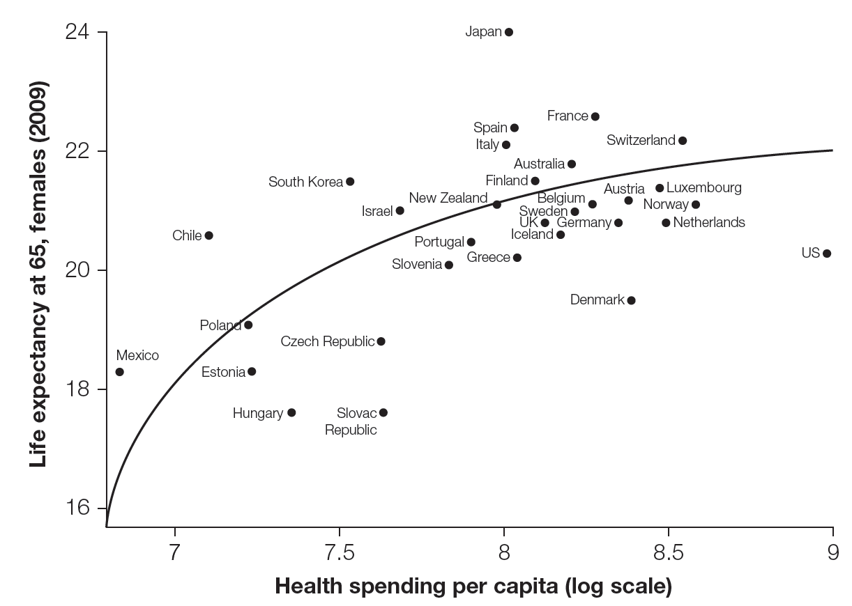
Comparing national health policies
Comparing a health outcome (like life expectancy) and expenditures can serve as a kind of report card for a nation’s health care system.
How much health is achieved at how much cost to wealth?
Does not provide a meaningful assessment of equity.

Slide 33
Comparing national health policies
But what if:
different countries have different inherent levels of health?
people in different countries value health differently?
countries differ in how much health inequality exists?
If countries differ in any of these ways, then the preceding graph is insufficient to render judgment on the effectiveness of health systems in different countries.

Slide 34
Differing inherent levels of health
It is not clear whether all countries share the same health production frontier (with some countries like the U.S. inefficiently below the frontier) or whether the U.S. is on a completely different HPF than the European countries.
One possibility is that the U.S. and other countries have different populations with different inherent health states. If so, the U.S. would be on a different HPF than the other countries.

Slide 35
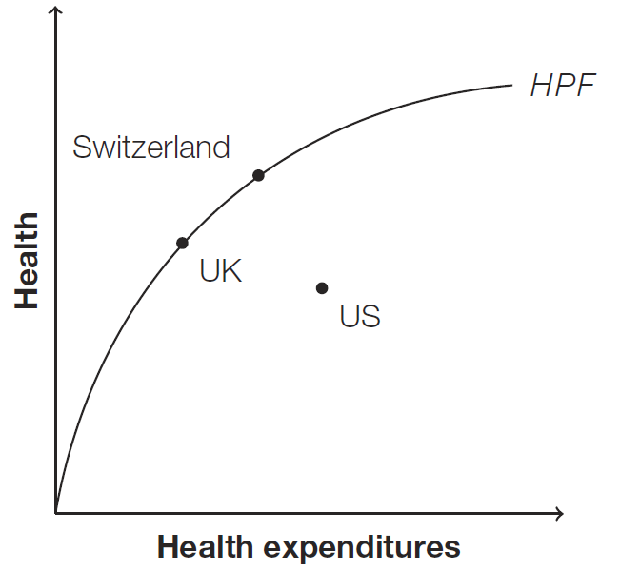
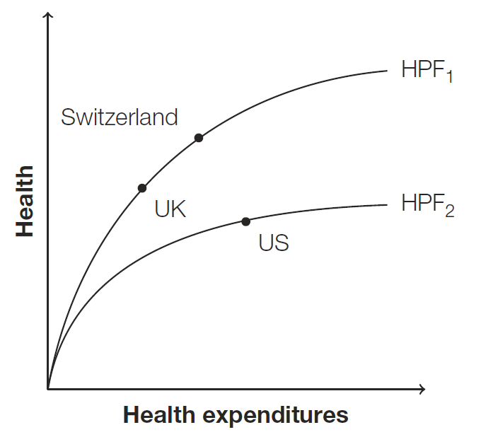
Differing inherent levels of health
In the first figure, the US shares the same HPF as the UK and Switzerland, so its health economy is operating inefficiently.
In Figure B, the US sits on a different HPF. Here, the U.S. is doing as well as it can given its inherent unhealthiness.

Slide 36
Differing preferences for health
Even if a country is productively efficient, and hence on its own health production frontier, this does not imply that the country is spending the optimal amount of money on health care.
Example: It is possible that the marginal dollar spent on education or parks produces more utility than the marginal dollar spent on health care.
Such a country is allocatively inefficient since it spends too much on health care relative to other activities.
In such cases, shifting money to other activities will reduce health, but increase the overall welfare of the population.

Slide 37
Conclusion
While government policy can address some of the problems created by information asymmetries, as we have seen, it is impossible to solve them all simultaneously.
Countries that have adopted policies that solve the adverse selection problem face a significant challenge in controlling moral hazard.
By contrast, in the U.S. a large segment of the population is without health insurance coverage, in part because its health policies do not fully solve the adverse selection problem.

